Slide 1

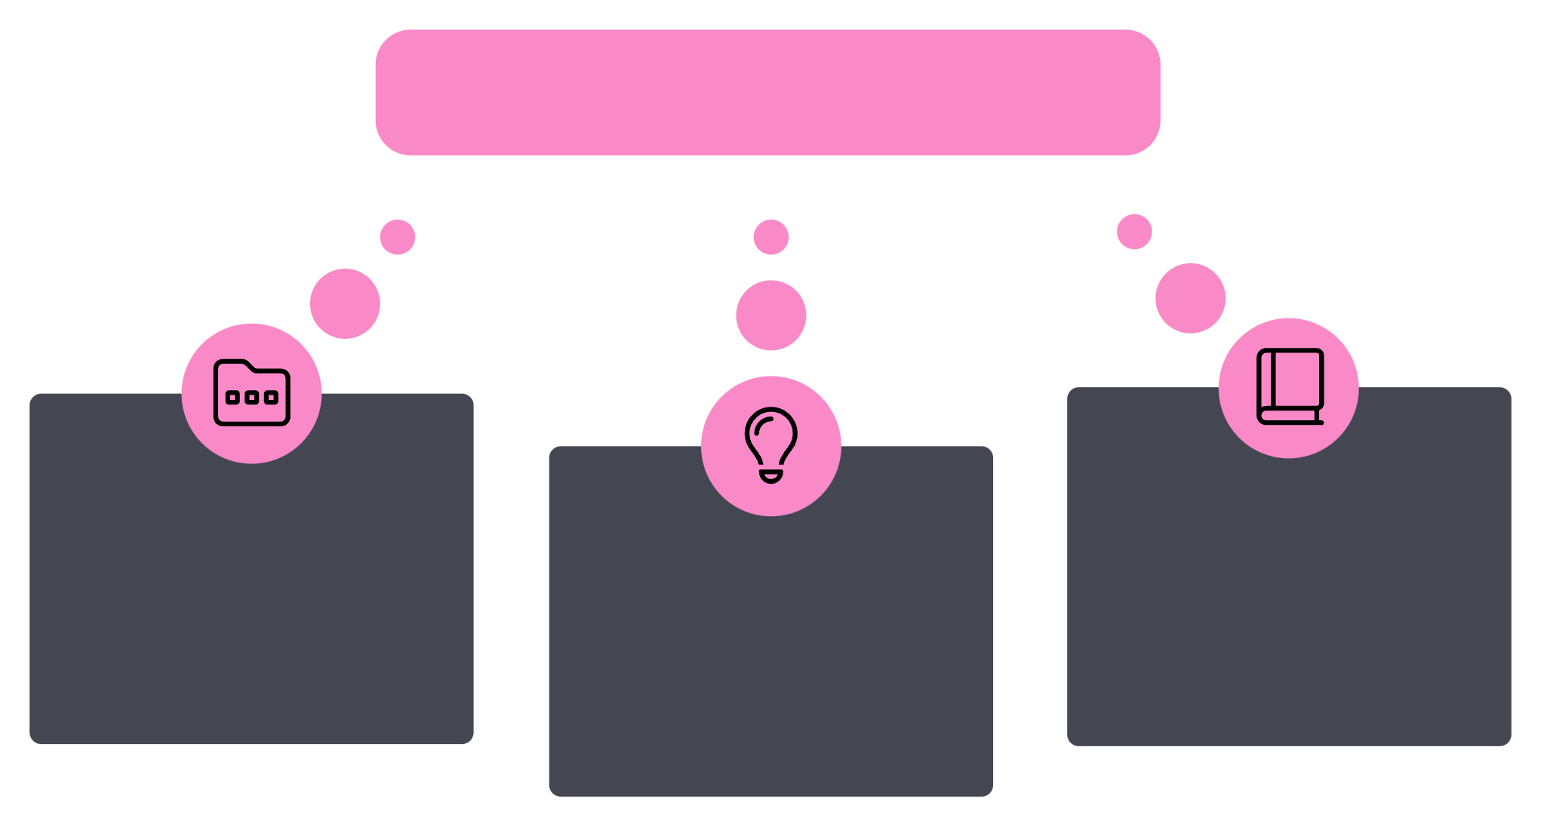



While competitors burn ₹1000s of crores on Ads….
Zerodha curated a unique growth story….
Unique Growth Engine
Invested in creating a content empire
Education-first content, no hard sell
Priortised earned attention

Slide 2

📊 What content-first marketing delivered
8M+
₹9,000+
active users
crores revenue
8 years
Zero
to category leadership
Ad spends
This wasn't luck. This was intent-based strategy.

Slide 3
📚 Zerodha Varsity
Think of it as the Khan Academy for beginners & professional investors…
15+ comprehensive modules
300+ lessons from basics to advanced
Available in Hindi + English
Completely free, no signups, no ads
The best part? It’s built to help everyone even if they’re not Zerodha users.

Slide 4
🌐 But Varsity was just the beginning...
They built an entire content ecosystem
📺 Markets by Zerodha (YouTube)
🎙️ The Daily Brief
📝 Z-Connect Blog
Expanded to podcast + newsletter + Twitter threads
Deep business insights and market analysis
The Daily Brief show
📧 The Chatter
📊 Aftermarket Report
Curated earnings call insights (read by fund managers)
Daily market summary newsletter
One piece for everyone. Each piece genuinely useful. Each piece building trust.

Slide 5
Markets by Zerodha - The Media Powerhouse
📺 Financial Media Operation
🎙️ The Daily Brief
🌍 The World, Simplified
Quickly became one of India's most popular daily podcasts and newsletters
Global version breaking down biggest trends in international markets
📧 The Chatter + Aftermarket Report
🇮🇳 Markets by Zerodha Hindi
Curated earnings insights + daily market summaries
Expanding language accessibility
Straightforward insights and explanation on complex markets.

Slide 6
🛠️ The Platform Layering
📱 Zerodha Pulse
1
Curated financial news aggregation platform
💻 Zerodha.tech
2
Technical insights for developers
🔗 Kite Connect API
3
Open platform for developers
📝 Z-Connect Blog
4
One of India's oldest finance blogs, a treasure trove of market evolution
This isn’t just content. It’s a whole infrastructure for long-term loyalty.

Slide 7

👥 Something beautiful happened next...
More people learned from Zerodha's content ecosystem….
Traders Shared Knowledge
Users became ambassadors
Word of mouth referrals exploded

Slide 8





⚠️ Zerodha’s Playbook? Built for Zerodha’s Context
Finance is complex
Bootstrapped Company
Trading requires Trust
First movers in the category

Slide 9





🎯 Here’s What to Bookmark!
Not a hack. Not a trend.Just honest strategy rooted in who you are…
Strategy
Industry
Timing
Constraints

Slide 10

Make Knowledge Work for You
🔍 Scales with knowledge
🌐 Think in Ecosystems
👥 Let Users Lead
Build trust by solving real user problems, not pushing products.
Layer content across formats - blogs, videos posts, tools, newsletters, forums…
From forums to feature requests, make users more than just customers.

Slide 11

Organic Growth. Lasting Impact.

